Slide 1

Student Examination System [Git Link] [Supporting Documents Drive Link]
Ahmed Hamdy
Nada Allam
Toka Aly
Hend Hamza

Slide 2
Required Minimum Project Features
Construct an automated system that can perform online exams and build SQL database for such system.
Requirements:
ERD & backup
Desktop Application
Database Dictionary (documentation)
Stored procedures
Select ,Insert update and delete in any table
Exam generation
Exam Answers
Exam Correction

Slide 3
Required Minimum Project Features
SSRS Reports:
Report that takes the track No parameter and returns the students information
Report that takes the student ID and returns the grades of the student in all courses.
Report that takes the instructor ID and returns the name of the courses that he teaches and the number of student per course.
Report that takes course ID and returns its topics (Course Questions Bank).
Report that takes exam number and returns the Questions in it and choices [freeform report]
Report that takes exam number and the student ID then returns the Questions in this exam with the student answers.
+ Desktop Application – Power BI Dashboards

Slide 4
Project Execution & Additional Features
Examination system for students
Multiple Branches
Multiple Tracks for each Branch
Multiple Courses for each Track
Questions Bank for each Course
Students that enroll in the Course
Exams that are randomly generated from Course Questions Bank
Graduates tracking for insights (Whether they got a job later on, etc.)
Instructors that are assigned to Courses
Supervisors that are assigned to Instructors
System Admins for adding, Tracks, Instructors & Students

Slide 5
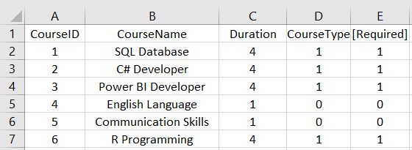
Courses Table
Course Type:
1 = Technical
0 = Soft Skills
Required:
1 = Required
0 = Optional

Slide 6
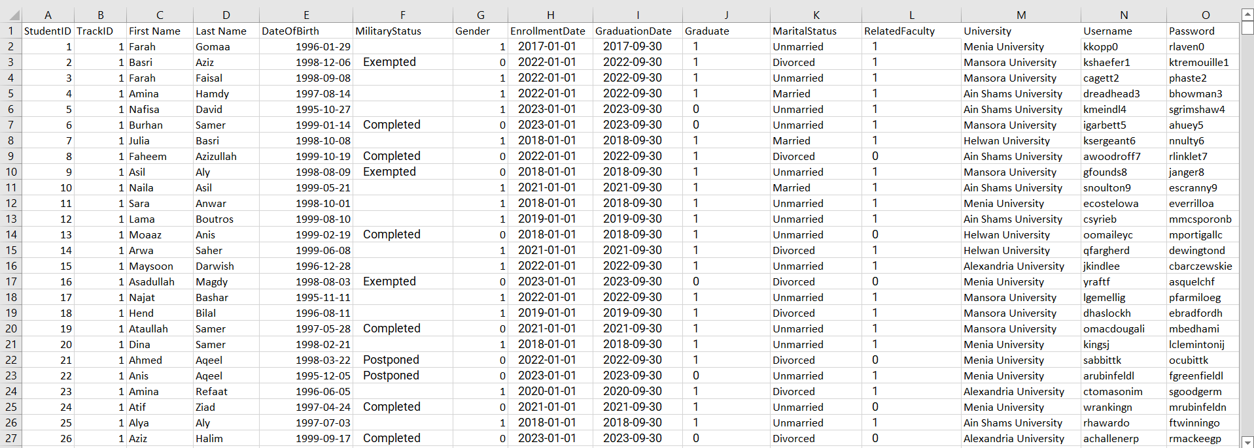
Student Table
Gender
1 = Female
0 = Male
Graduate:
1 = Graduate
0 = Undergrad
Related Faculty:
1 = Programming Background
0 = Non-Programming Background

Slide 7
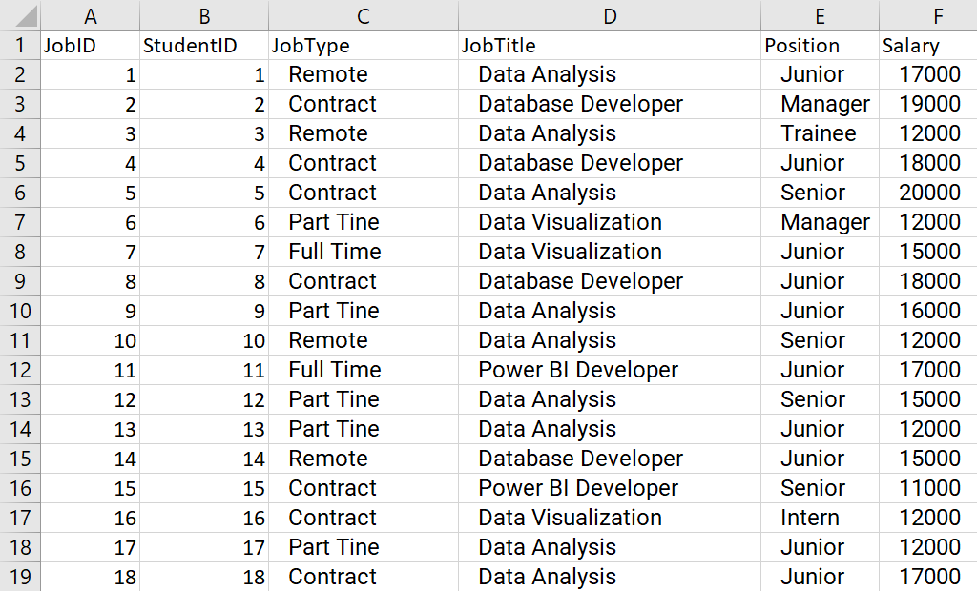
Job Table
We will be tracking students after graduating by collecting info for better business insights and deeper analysis

Slide 8
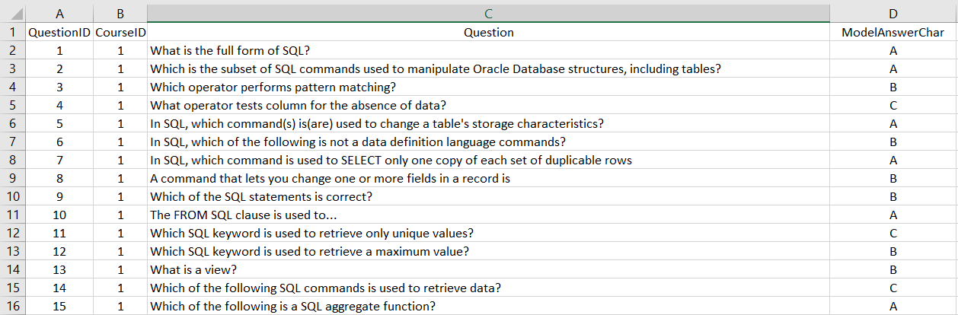
Questions Table
Each question belongs to a course and has a model answer Ex. A and 2 wrong answers Ex. B, C

Slide 9
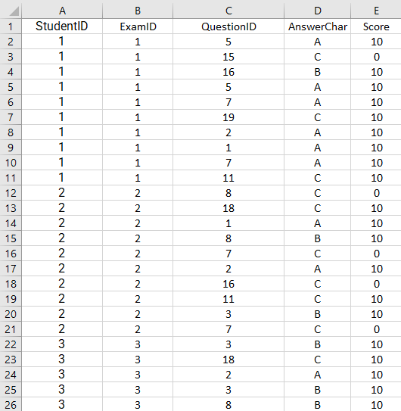
Student Answer Table
How do we correct exams?
We compare the AnswerChar with QuestionID
If Student AnswerChar matches ModelAnswerChar
Then Question score is 10 and 0 if it doesn’t match (Wrong)
Since all of our exams are 10 Questions each
Then cumulative exam grades would be between 100 and 0

Slide 10
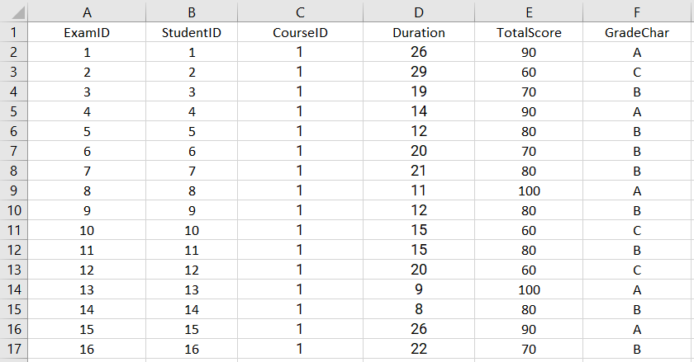
Exam Table
Grades:
A = 90 – 100
B = 70 – 80
C = 50 – 60
F = 0 – 40

Slide 11
Tools & Technologies
Microsoft Excel for data creation and manipulation
Microsoft SQL Server Management Studio
Visual Studio for C# & SSRS
GitHub for deployment
Power BI for data manipulation and dashboards
Figma for Application Wireframe & Prototype
Adobe Photoshop & Illustrator for Power BI designs
Adobe After Effects for Power BI Videos

Slide 12
Tools & Technologies
Microsoft Excel for data creation and manipulation
Microsoft SQL Server Management Studio
Visual Studio for C# & SSRS
GitHub for deployment
Power BI for data manipulation and dashboards
Figma for Application Wireframe & Prototype
Adobe Photoshop & Illustrator for Power BI designs
Adobe After Effects for Power BI Videos

Slide 13
Demo

